Slide 1

Santander
Product Recommendation
TEAM KWT Wen Li Yisong Tao Lydia Kan

Slide 2




01
Introduction
02
Data Cleaning and EDA
03
Feature Engineering
AGENDA
04
Training Model
05
Result and Finding
06
Future Steps

Slide 3


Introduction
Project Description
Santander Bank offers their customers personalized product recommendations time to time, in order to meet the individuals needs and satisfaction.
This challenge seeks to improve the recommendation system by predicting which products their existing customers will use in the next month based on their past behavior.
Goal
Achieve top 5% ranking and MAP@7 score on Kaggle leader board

Slide 4
Introduction
01
02
Data Size
03
Training Set: 13,647,409
Test Set:
Input Features
04
Categorical: 45
Continuous: 3
Customer Info. :
1: 24
Product Purchased Info:
25:48
Output Features
Multi-Classifier
Recommended Products : 7
Evaluation
MAP@7

Slide 5
Workflow
Features
Engineering
Method 1
Random Forest ﹡
Naïve Bayes ﹡ XGBoost
Model
Training
Ensemble
Features
Engineering
Method 2
Data
Cleaning
EDA
Random Forest ﹡ Naïve Bayes ﹡ XGBoost Neural Network ﹡ Collaborative Filtering
Model
Training
Features
Engineering
Method 3
Models
Stacking
Random Forest﹡Naïve Bayes﹡XGBoost Neural Network ﹡Collaborative Filtering AdaBoost
Model
Training
Method 4
Features
Engineering

Slide 6
Data Cleaning
Imputation
Dropping Features
Contain Missing Values:
24 Features
Drop 5 Features:
Having over 95% missing value
Repetitive of other features

Slide 7
Imputation
Unknown
Common Type
Others
Products
Sex
Employee Index
Country Residency
Segmentation
Residence Index
Foreigner Index
Channel to Join
Primary
Province Name
Customer Type
Activity Index
Rent
New Customer – New
Seniority – Min
Age – Scale, Mean
Relationship Type – ‘A’
Deceased Index – ‘N’
Payroll - 0
Pensions - 0

Slide 8
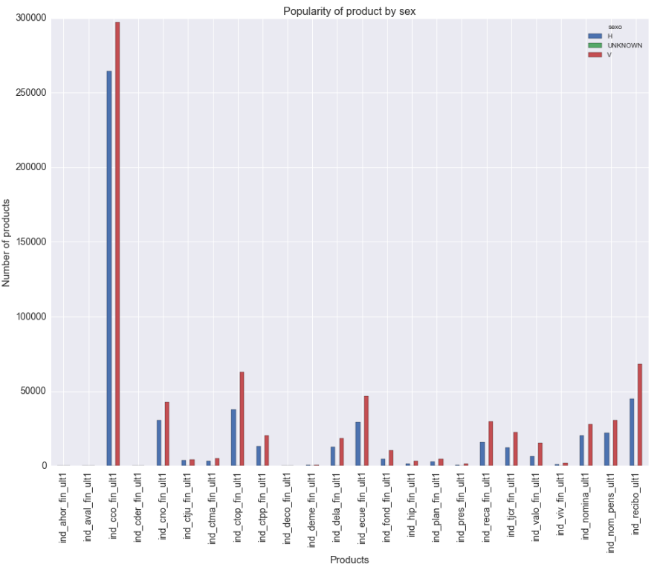
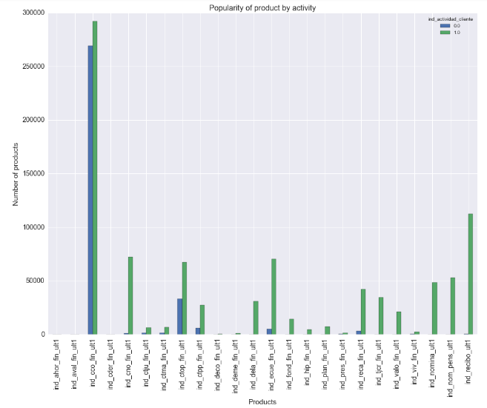
EDA
Product Sales Related to Customer’s Info - 2016.5

Slide 9
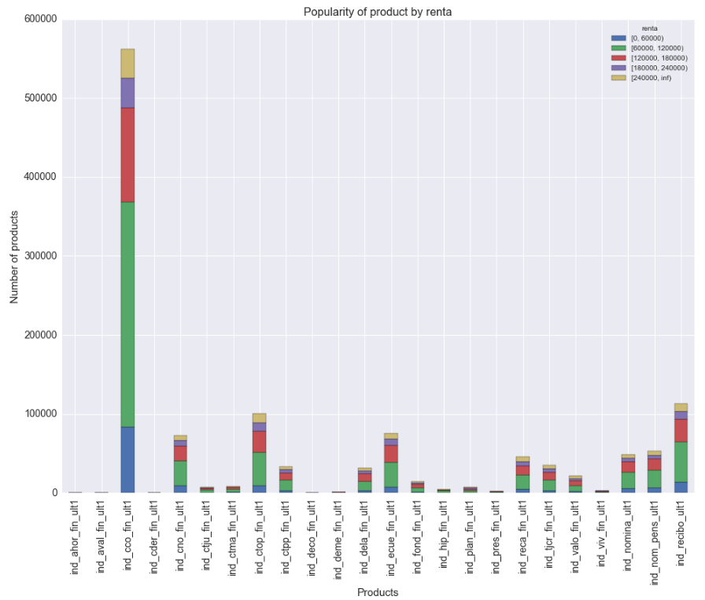
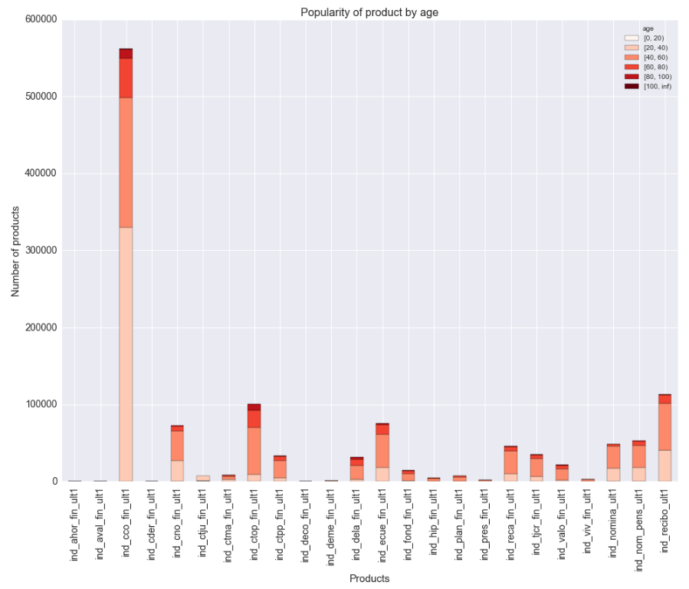
EDA
Product Sales Related to Customer’s Info - 2016.5

Slide 10
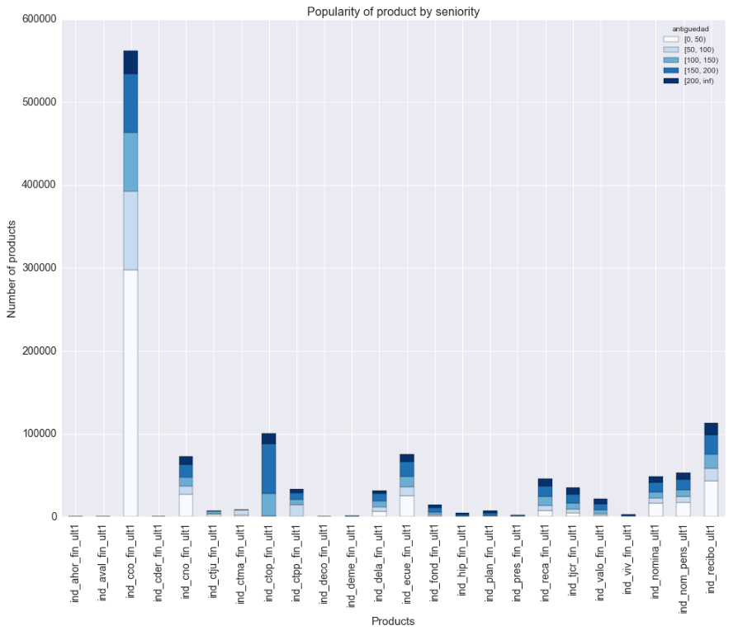
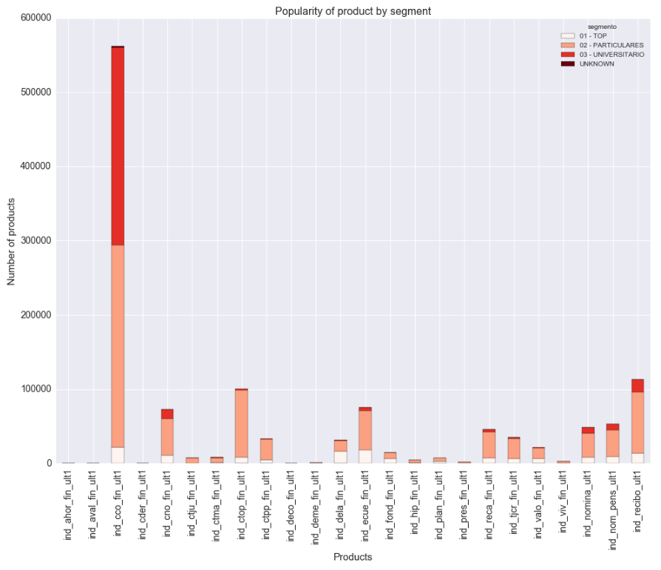
EDA
Product Sales Related to Customer’s Info - 2016.5

Slide 11
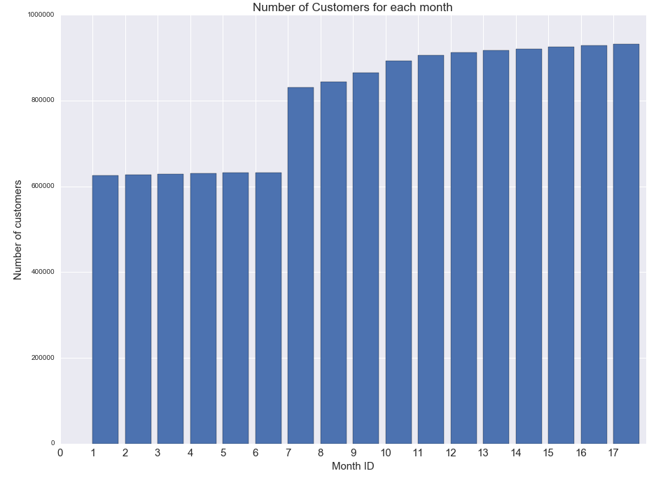
EDA
Number of Customers by Time

Slide 12
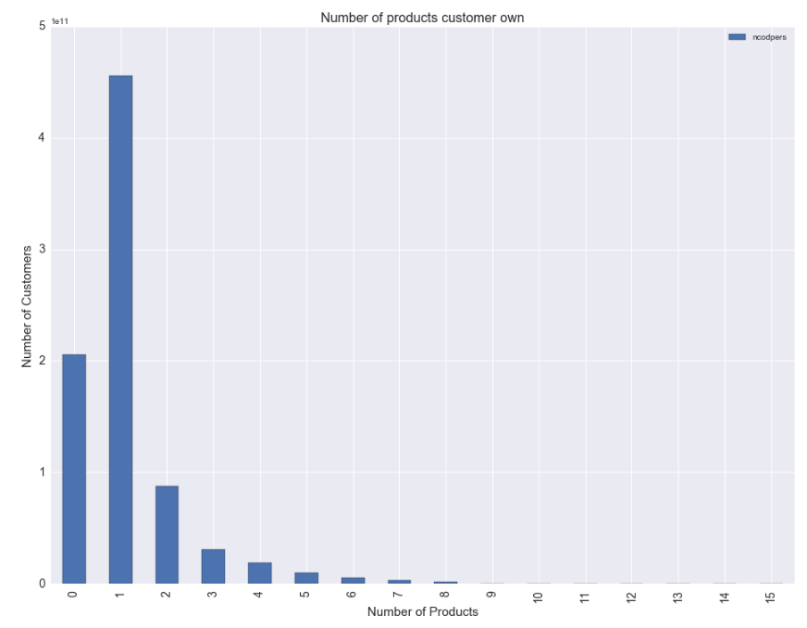
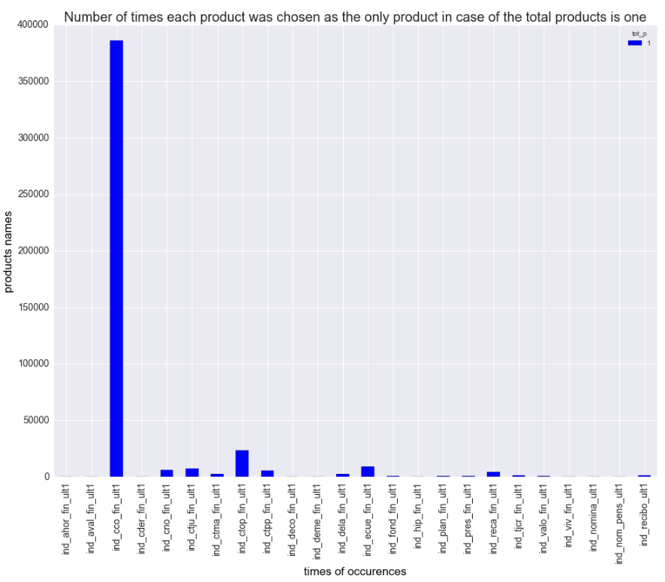
EDA
Number of Product Own - 2016.5

Slide 13
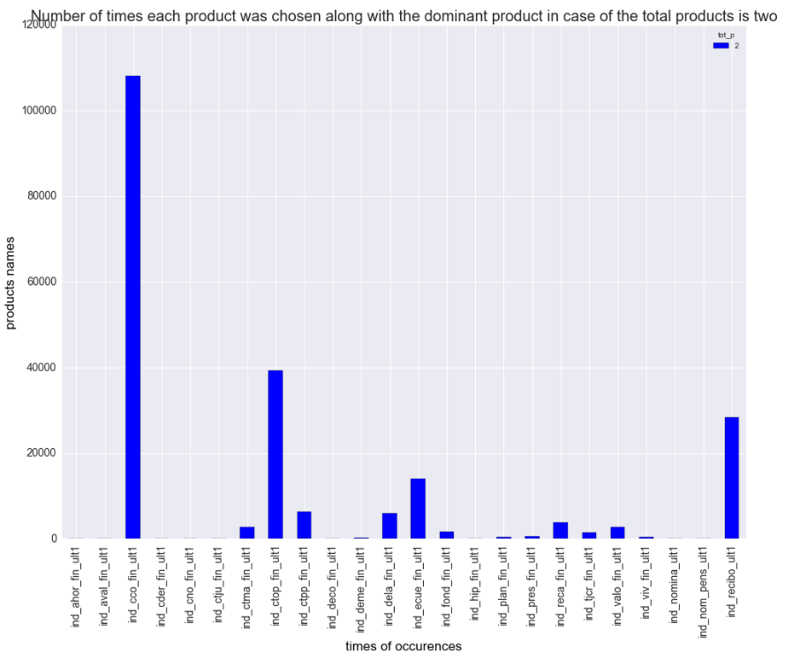
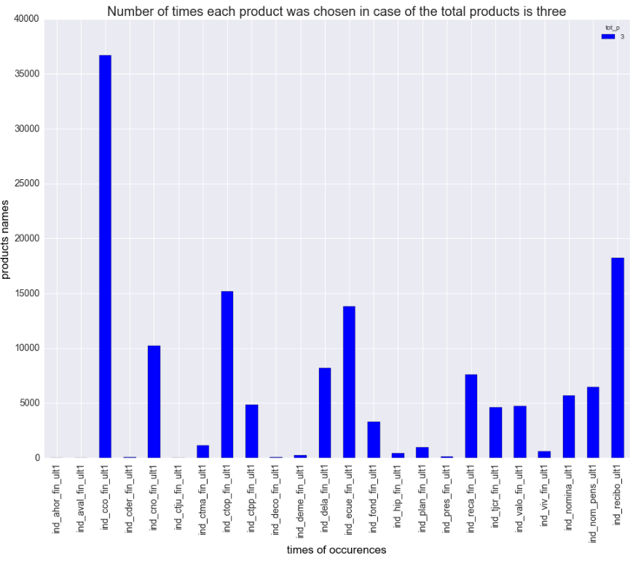
EDA
Number of Product Own - 2016.5

Slide 14
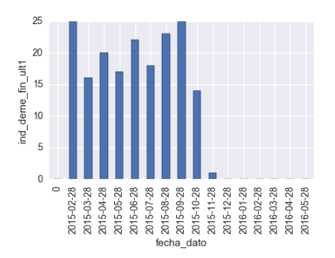
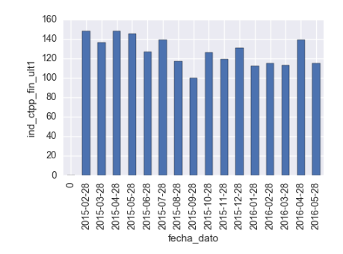
EDA
Number of Product Sales by Time

Slide 15
Feature Engineering
Input Features
Encoding
Use adjacent month
i.e. 2016.1-2016.2
Input Features
Previous Month Products
Use adjacent month
i.e. 2016.1-2016.2
Use the same month
i.e. 2015.5 – 2016.5
Use the same month
i.e. 2015.5 – 2016.5
Output Features
Encoding
Use the seasonal month
i.e. 2016.3 – 2016.6
Use the seasonal month
i.e. 2016.3 – 2016.6
Input Features
Create Change Features
i.e. Previous - Current
Input Features
Time Series
Level = -1, 0, 1
Time Series
Pick significant pattern
Level = 0 , 1
&
Create as new
input features
Output Features
Drop features & add weight
Based on popularity of the products
Make recommendation based on products’ popularity

Slide 16
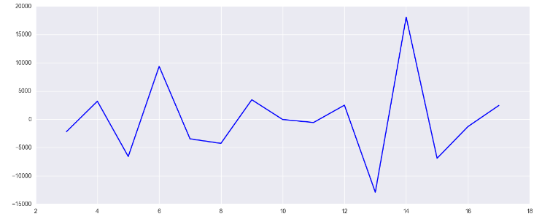
Time Series
Test Statistic -3.163039
p-value 0.022226
No. Lags Used 4.000000
Critical Value (5%) -3.232950
Critical Value (1%) -4.331573
Critical Value (10%) -2.748700
Results of Dickey - Fuller Test
Product Pension

Slide 17
Models Training
Naïve Bayes &
Genetic Algorithm
Neural Network
Collaborative
Filtering
0.016
0.0269
0.0
0.0272
0.01995
0.02364
Random Forest
XGBoost
AdaBoost

Slide 18
Ensemble
Popularity Collaborate Filter Naïve Bayes 0.0276

Slide 19
Result & Findings

Slide 20
Future Steps

